Slide 1


IDS 1721
Computing and Problem Solving for STEM Chapter 04
Vectors and graphics

Slide 2
Arrays
Arrays are fundamental data structures that allow you to store, organize, and manipulate data
An array is essentially a collection of elements
Each element is indexed by a position
Arrays in MATLAB:
Vectors:
Row Vector: A 1D array with elements arranged in a single row.
Column Vector: A 1D array with elements arranged in a single column.
Matrices: A 2D array with elements arranged in rows and columns.
Multidimensional Arrays: Arrays with more than two dimensions, often used in advanced data structures.

Slide 3
Creating Vectors
Row Vector: You can create a row vector by enclosing a sequence of numbers in square brackets [ ], separating elements with spaces or commas,
>> r = [10 20 30 40 50];
Column Vector: A column vector is created by separating the elements with semicolons,
>> c = [5; 15; 25; 35];
Try the above commands in your command window.

Slide 4
More ways to create vectors
Colon Operator: The colon operator : is used to create vectors with a regular sequence of numbers.
>> v1 = 1:5;
Specify Step Size: The colon operator can also specify a step size between elements.
>> v2 = 1:0.5:3;
Linspace Function: linspace generates linearly spaced vectors with a specified number of elements.
>> v3 = linspace(0, 10, 5);

Slide 5
Matrices
We can create a matrix by entering elements row by row inside square brackets.
Separate elements within a row by spaces or commas, and separate rows by semicolons.
>> A = [1 2 3 4; 5 6 7 8; 9 10 11 12];

Slide 6
Special matrices
Zero Matrix: The zeros function creates a matrix of zeros.
>> M1 = zeros(3, 4);
Ones Matrix: The ones function creates a matrix of ones.
>> M2 = ones(2, 5);
Identity Matrix: The eye function creates an identity matrix.
>> M3 = eye(4);
Random Matrix: The rand function generates matrices with random values between 0 and 1.
>> M4 = rand(3, 3);

Slide 7
Accessing Vectors
We can access elements of arrays and subarrays to extract, modify, or use specific parts of an array for further computations.
Elements in the array can be accessed using the position indices using ( )
Row Vector Example:
>> r = [10, 20, 30, 40, 50];
>> element = r(3);
Column Vector Example:
>> c = [5; 15; 25; 35];
>> element = c(2);

Slide 8
Accessing Matrices
>> A = [1 2 3 4; 5 6 7 8; 9 10 11 12];
Use parentheses ( ) to access specific elements in an array by specifying row and column indices.
>> element = A(2, 3);
Modifying Elements: You can change an array element by assigning a new value to it.
>> A(1, 2) = -15;

Slide 9
Multiple elements
>> r = [10 20 30 40 50]
>> A = [1 2 3 4; 5 6 7 8; 9 10 11 12];
You can also access multiple elements from a matrix or a vector at once by specifying a range or a set of indices.
>> subVec = r(2:4); >> row = A(2,:);
>> col = A(:,3);
>> subMat = A(1:2, 2:3);

Slide 10
Special Indexing
The keyword end can be used to reference the last element of a dimension.
Try the following in the command window...
For vectors
>> lastEl = r(end);
>> secLast = r(end-1);
>> subVec = vec(4:end);
For matrices
>> lastRow = A(end, :);

Slide 11
Logical Indexing
Instead of specifying indices, we can extract elements that satisfy a certain condition by applying a logical expression.
>> vec = [2 –1 4 3 7 0 -3];
>> subVec = vec(vec>3);
>> matB = [2 5 8; 3 6 9; 1 4 7]; >> result = matrixB(matrixB > 5);

Slide 12
Extracting properties of an array
The size of an array refers to the number of rows and columns (or elements in each dimension for multi-dimensional arrays). >> sz = size(A);
The length function returns the largest dimension of vectors or matrices (useful for vectors). >>len = length(B);
To determine the total number of elements in an array, we use the numel function which returns the total number of elements in the array, irrespective of the number of dimensions. >> totEl = numel(A);

Slide 13
Exercise 1: Output the elements with odd indices
Given an array of integers from user, display the elements with odd indices.
Example:
Input: [ 4, 2, 6, 7, 1, 9, 14, 5]
Output: 4 6 1 14

Slide 14
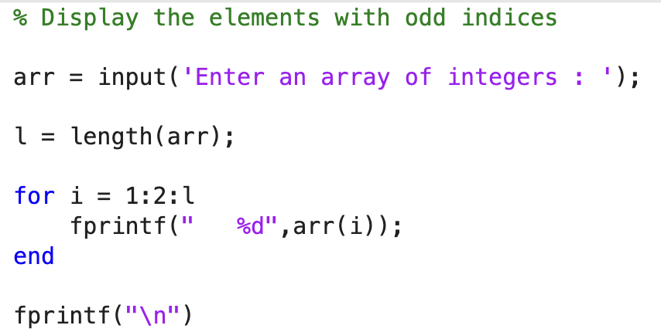

Slide 15
Exercise 2 : Find the max/min value
Given an array of integers from user, find the maximum value of the array.
Examples:
Input: [22, 14, 8, 17, 35, 3] Output: Maximum value = 35

Slide 16
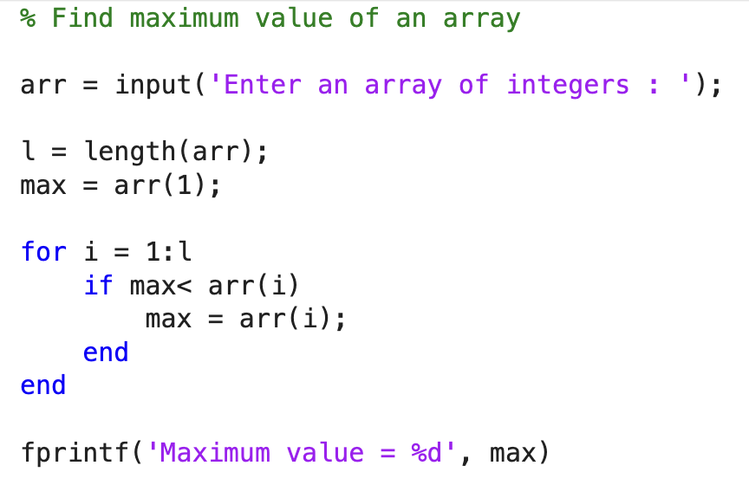

Slide 17
Exercise 3: Reverse an array
Given an array arr from the user, reverse the order of the array.
Rearrange the elements such that the first element becomes the last, the second element becomes second last and so on...
Examples:
Input: arr = [1, 4, 3, 2, 6, 5] Output: 5 6 2 3 4 1
Input: arr = [4, 2, 1, 3] Output: 3 1 2 4

Slide 18
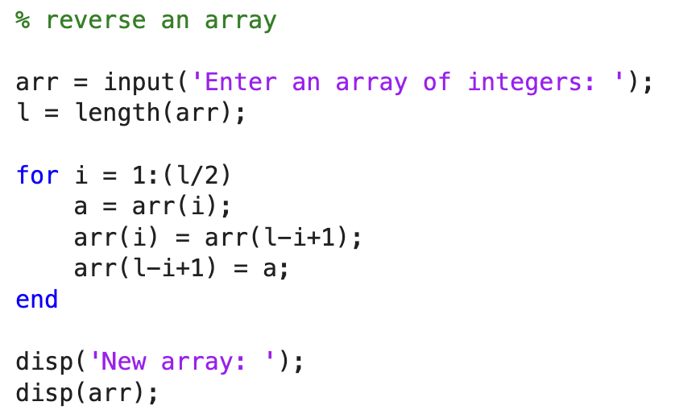

Slide 19
Plotting a graph using array
To plot trigonometric functions in MATLAB and annotate the graph, we can follow these steps.
Steps:
Define the range of x values.
Calculate the corresponding y values for sine and cosine.
Plot the graphs.
Annotate the graph with labels, arrows, and markers for specific points.

Slide 20
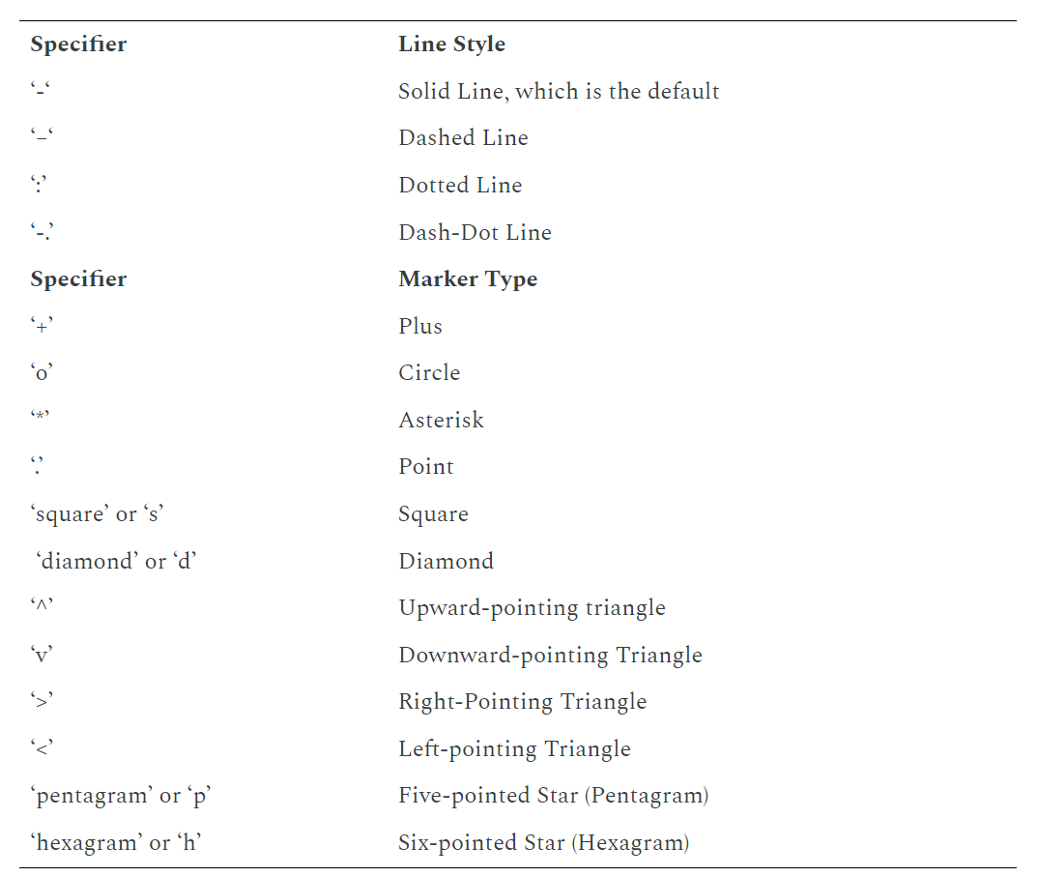
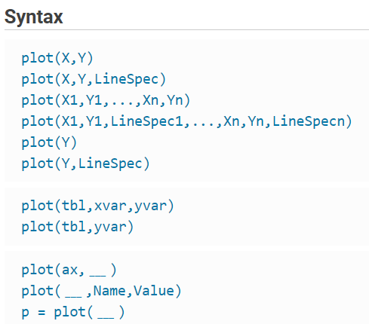
plot()
There are several marker types, and several line types
https://www.mathworks.com/help/matlab/ref/plot.html
Notes:
https://www.mathworks.com/help/matlab/ref/plot.html
Description
Vector and Matrix Data
example
plot(X,Y) creates a 2-D line plot of the data in Y versus the corresponding values in X.
To plot a set of coordinates connected by line segments, specify X and Y as vectors of the same length.
To plot multiple sets of coordinates on the same set of axes, specify at least one of X or Y as a matrix.
plot(X,Y,LineSpec) creates the plot using the specified line style, marker, and color.
example
plot(X1,Y1,...,Xn,Yn) plots multiple pairs of x- and y-coordinates on the same set of axes. Use this syntax as an alternative to specifying coordinates as matrices.
example
plot(X1,Y1,LineSpec1,...,Xn,Yn,LineSpecn) assigns specific line styles, markers, and colors to each x-y pair. You can specify LineSpec for some x-y pairs and omit it for others. For example, plot(X1,Y1,"o",X2,Y2) specifies markers for the first x-y pair but not for the second pair.
example
plot(Y) plots Y against an implicit set of x-coordinates.
If Y is a vector, the x-coordinates range from 1 to length(Y).
If Y is a matrix, the plot contains one line for each column in Y. The x-coordinates range from 1 to the number of rows in Y.
If Y contains complex numbers, MATLAB® plots the imaginary part of Y versus the real part of Y. If you specify both X and Y, the imaginary part is ignored.
plot(Y,LineSpec) plots Y using implicit x-coordinates, and specifies the line style, marker, and color.

Slide 21
Built-in Mathematical Functions
MATLAB has a rich library of built-in mathematical functions that can be applied directly to arrays. Some common functions include:
Sine, Cosine, and Tangent:
>> X = [0, pi/4, pi/2, pi]; >> S = sin(X); % Sine of each element >> C = cos(X); % Cosine of each element >> T = tan(X); % Tangent of each element
Exponential and Logarithms:
>> A = [1, 2, 3; 4, 5, 6]; >> E = exp(A); % Exponential of each element >> L = log(A); % Natural logarithm of each element >> L10 = log10(A); % Logarithm base 10 of each element
Square Root and Absolute Value:
>> A = [-9, 16, 25]; >> SQ = sqrt(A); % Square root of each element >> ABS = abs(A); % Absolute value of each element

Slide 22
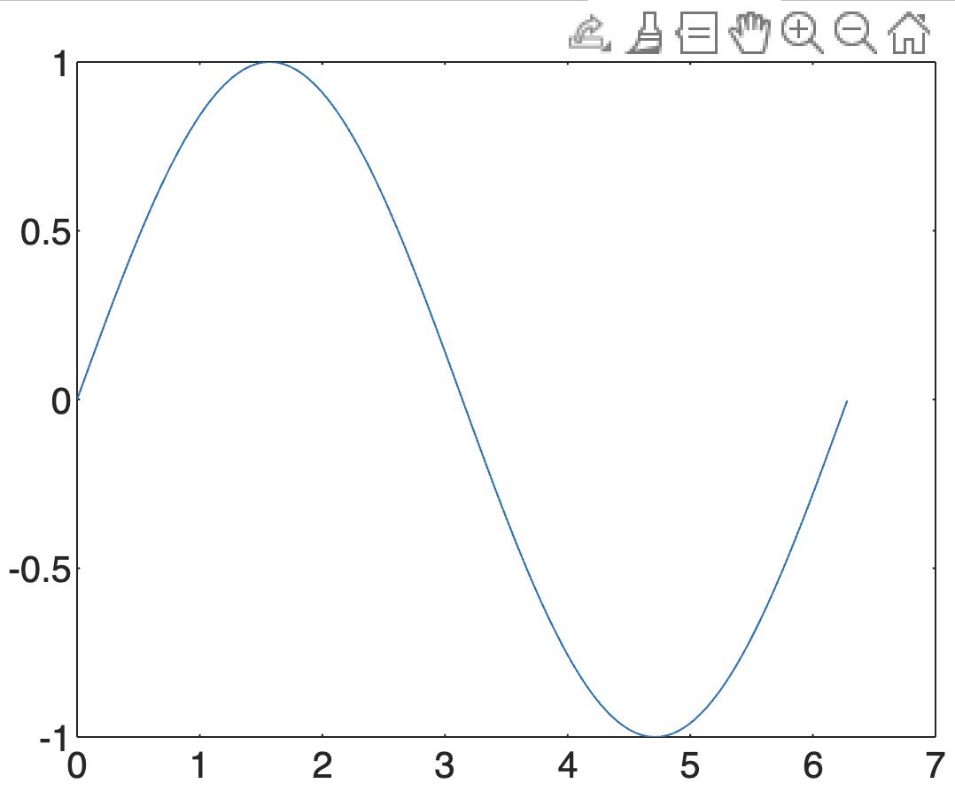
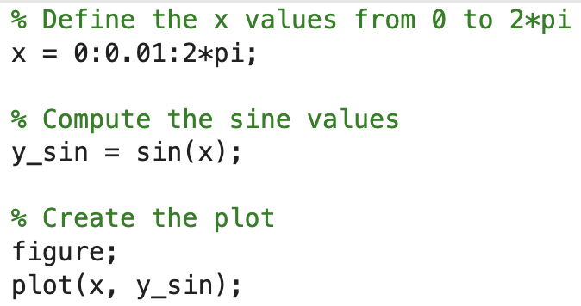
Plot a function

Slide 23
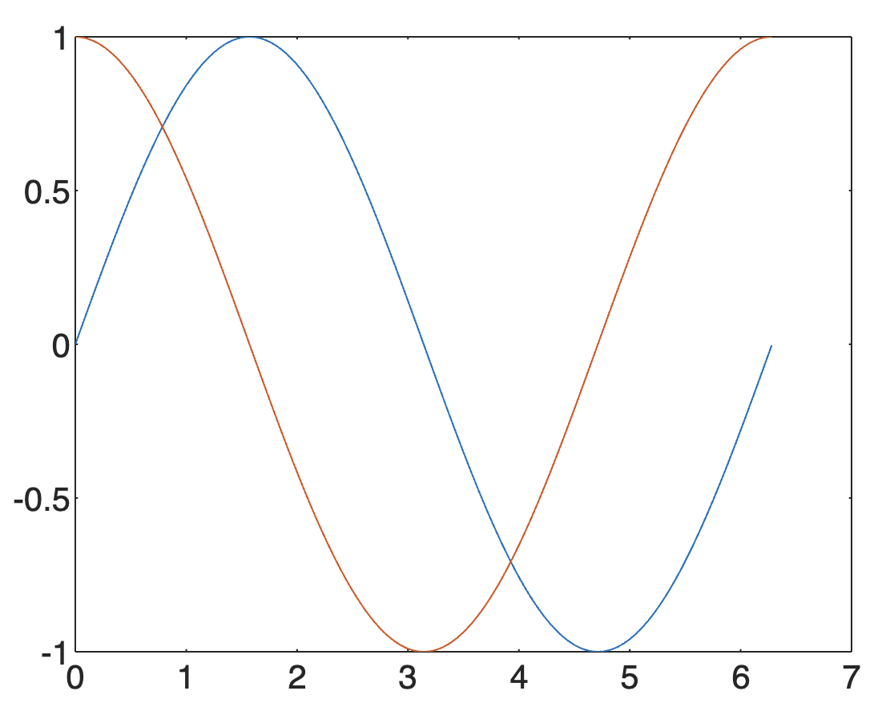
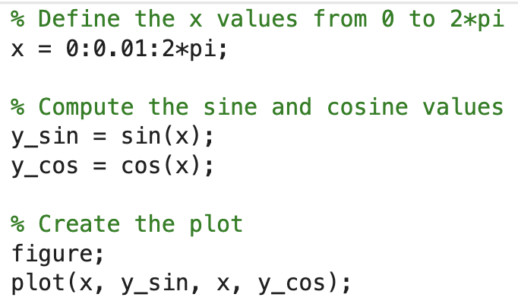
Plot two graphs in one axis

Slide 24
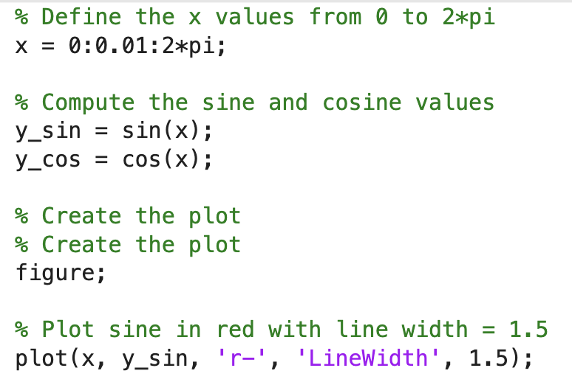
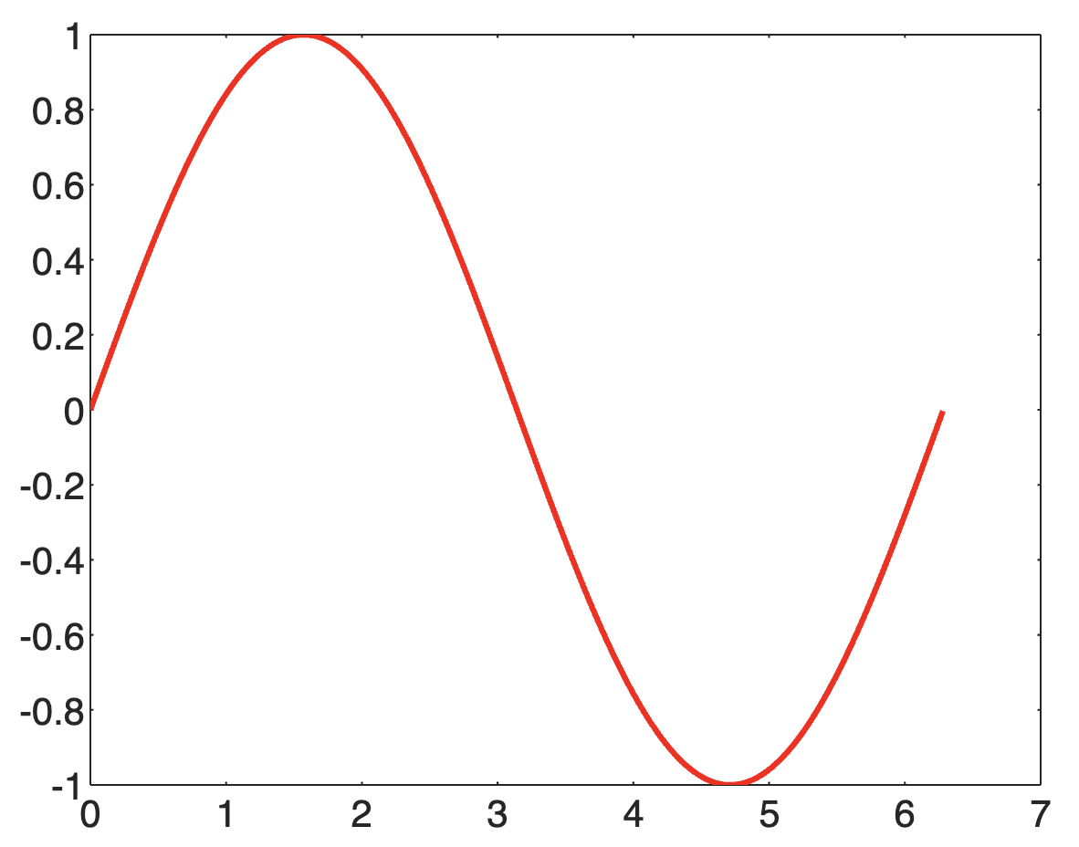
Plot specifications

Slide 25
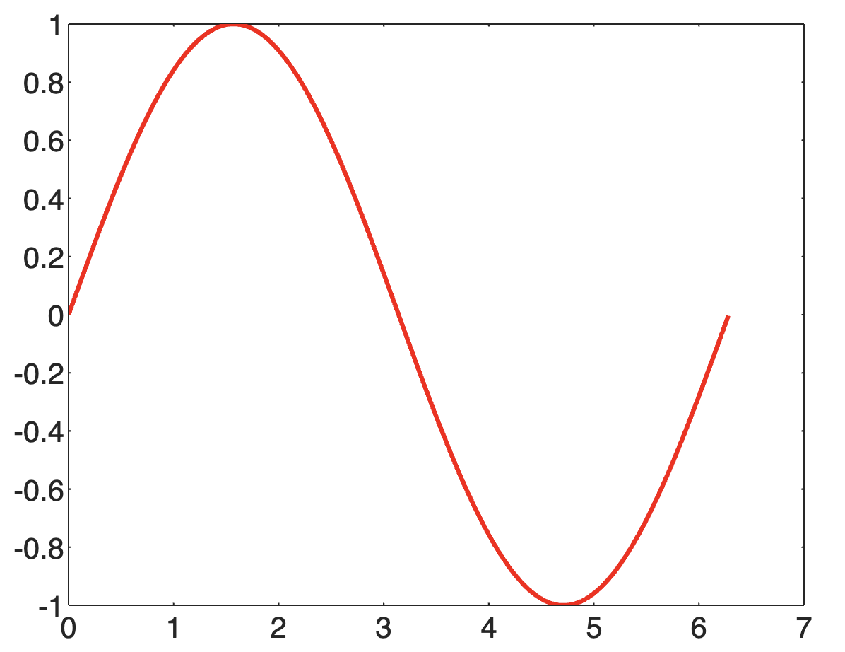
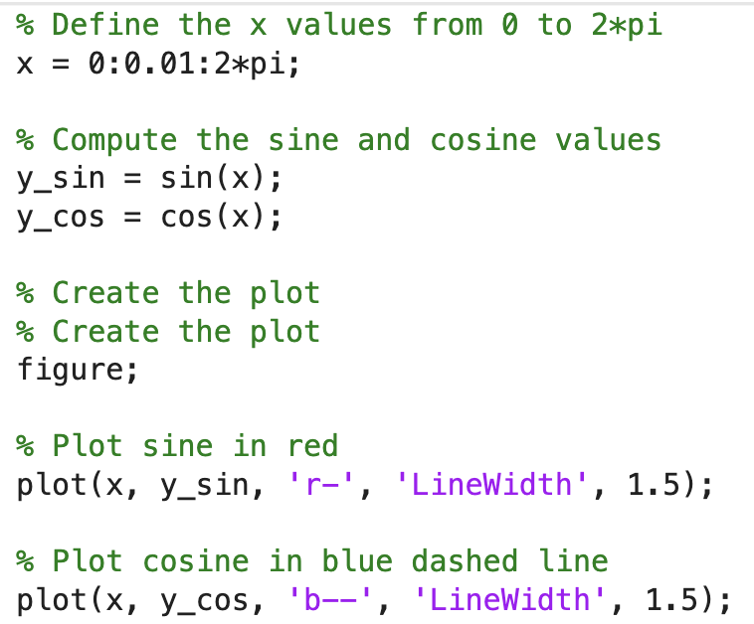
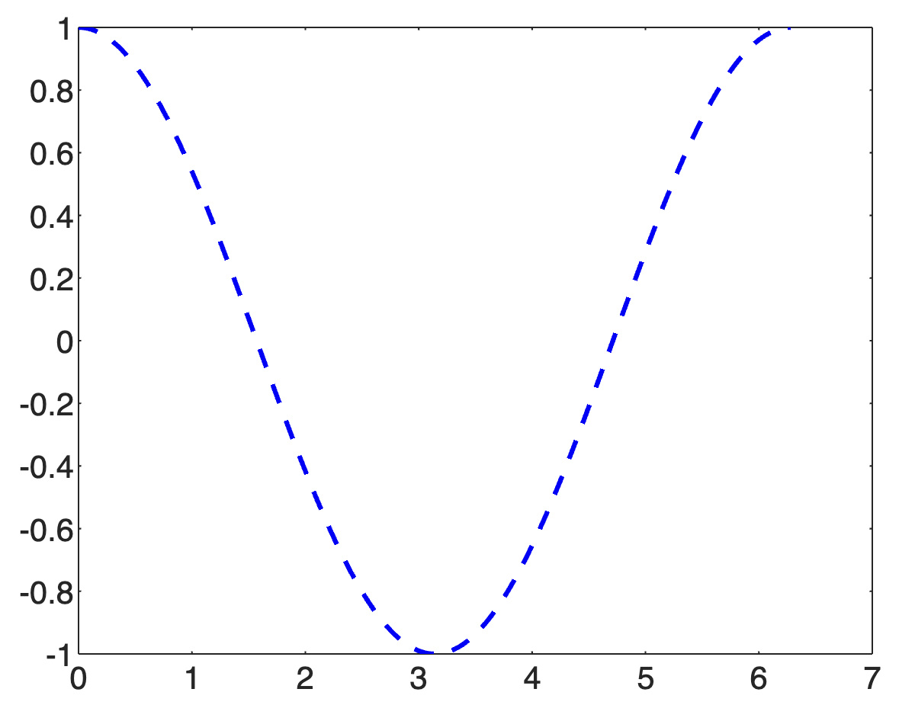
Create separate plots

Slide 26
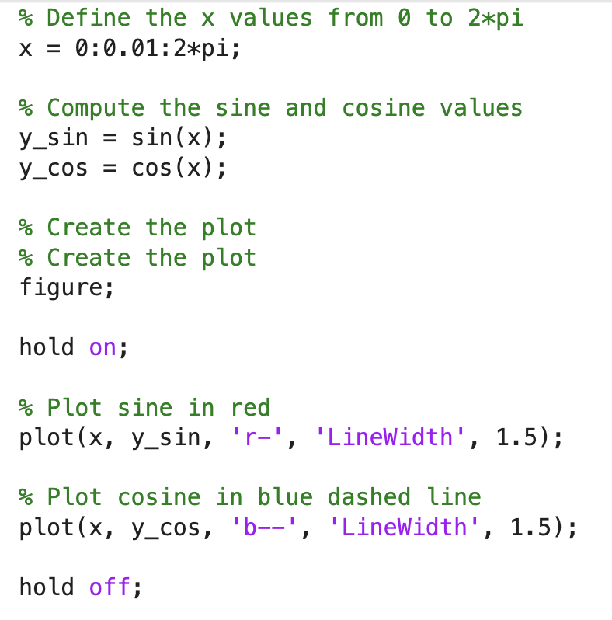
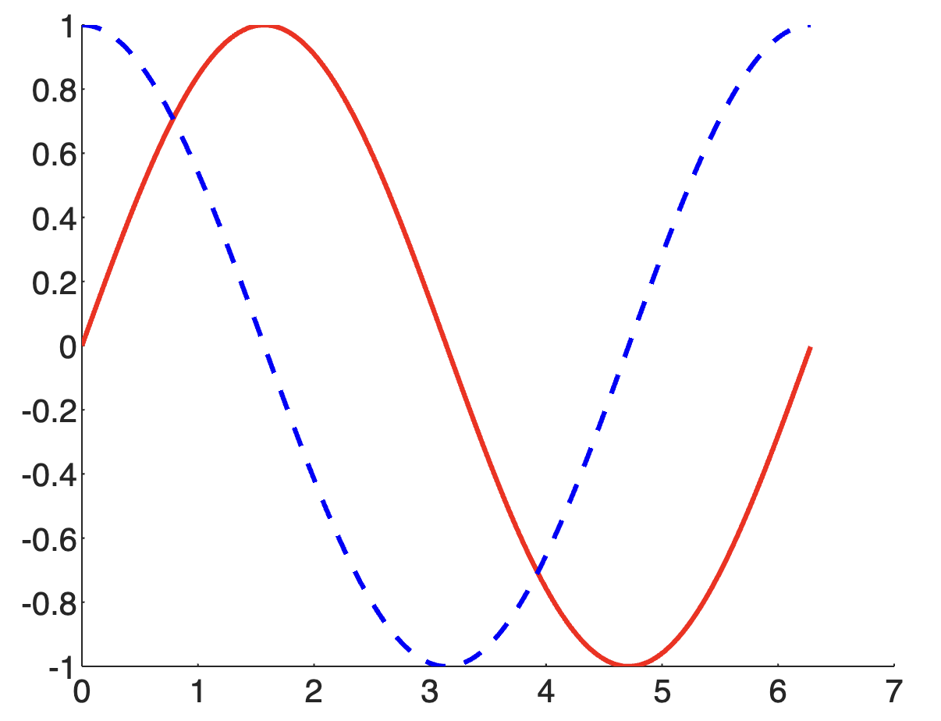
Combine the plots to one axis

Slide 27
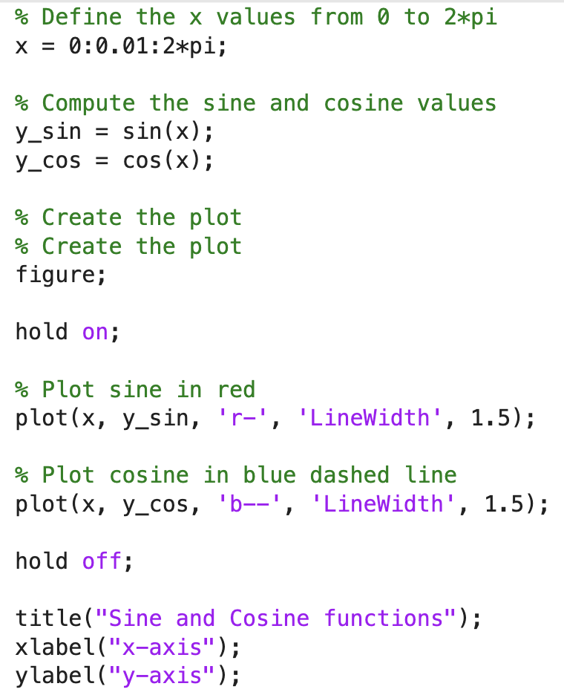
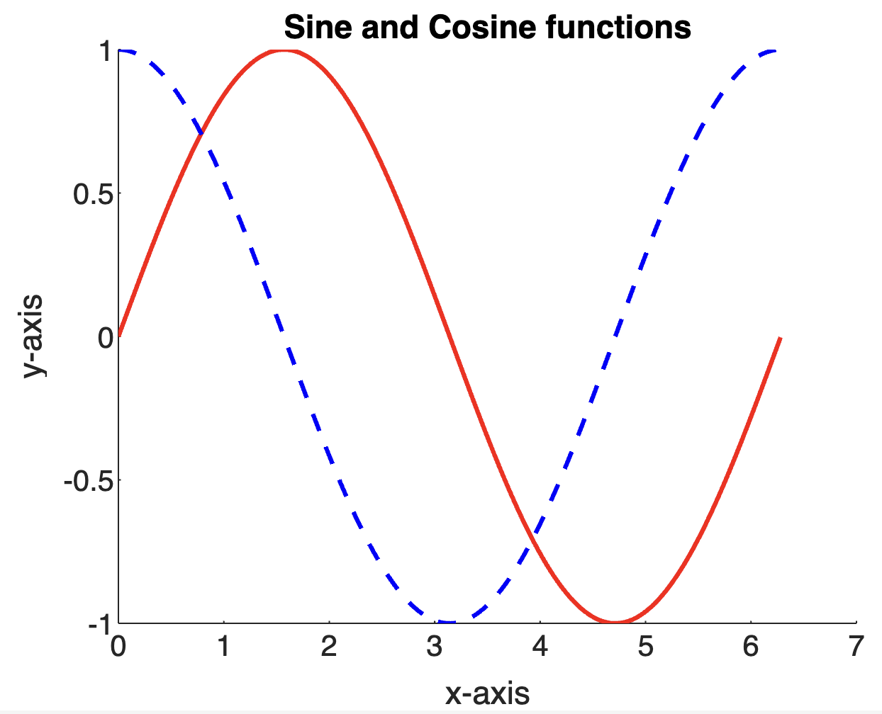
Add title and labels

Slide 28
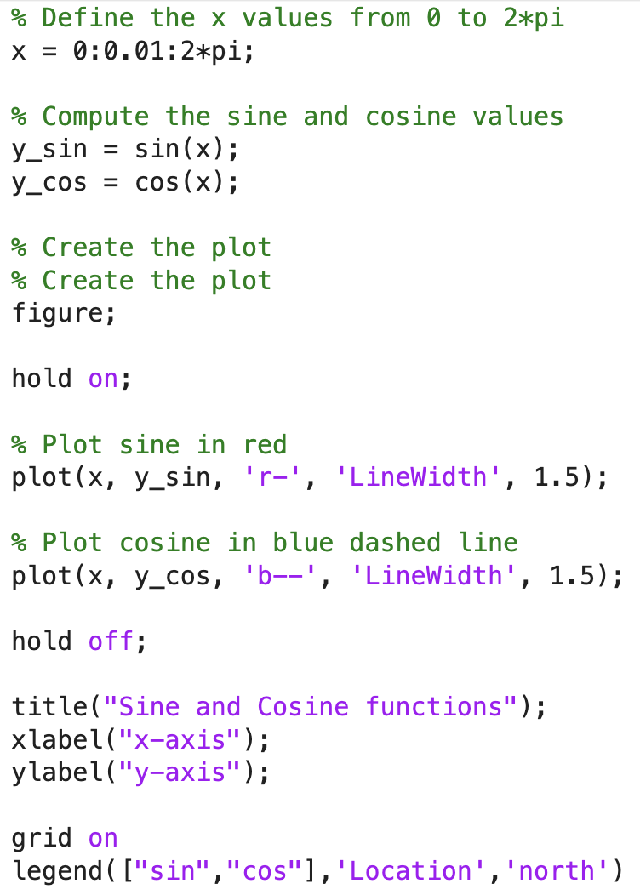
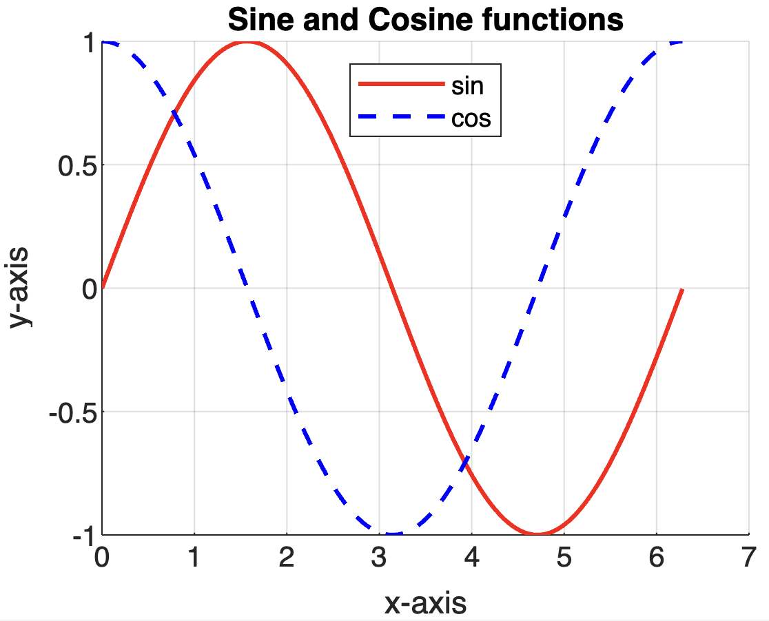
Turn on grid; Add a legend

